Slide 1
Agile Quality Assurance and Testing
Aruna Kumbhar

Slide 2
Revise
Advanced Agile Estimation
Agile Metrics
Agile Quality Assurance
Software Testing – Functional Testing, UI Testing, Performance Testing, Security Testing

Slide 3
Agile Testing
Agile Testing is a software testing approach where testing is performed continuously throughout the development process, instead of waiting until coding is complete
Traditional Testing
Agile Testing
Plan
↓
Develop
↓
Test
↓
Improve
↓
Develop More
↓
Test Again
Requirements
↓
Design
↓
Coding
↓
Testing
↓
Deployment

Slide 4
Principles of Agile Testers
An Agile Tester is not just someone who finds bugs. They help the team build quality software
Principle 1: Test Early
Principle 2: Test Continuously
Don't wait until coding is finished
Every sprint includes testing.
Requirement
↓
Test Idea
↓
Coding
↓
Testing
Sprint 1
Develop
Test
Sprint 2
Develop
Test
Sprint 3
Develop
Test
Early testing catches bugs cheaply

Slide 5
Principles of Agile Testers
Principle 3: Whole Team Owns Quality
Not only testers.
Everyone tests
Principle 4: Customer Collaboration
Developer
Tester
Product Owner
Customer
Everyone contributes.
Customer checks whether the software meets expectations
Instead of
"Did we build it correctly?"
Ask
"Did we build the right thing?"

Slide 6
Principles of Agile Testers
Principle 5: Fast Feedback
Principle 6: Automation Wherever Possible
If a bug is found today, fix it today.
Not after three months.
Instead of repeating manual tests every sprint, Use automation tools.
Example
Instead of testing login manually 500 times,
Run automated script.
Principle 7: Simplicity
Don't write unnecessary tests.
Write useful tests.

Slide 7
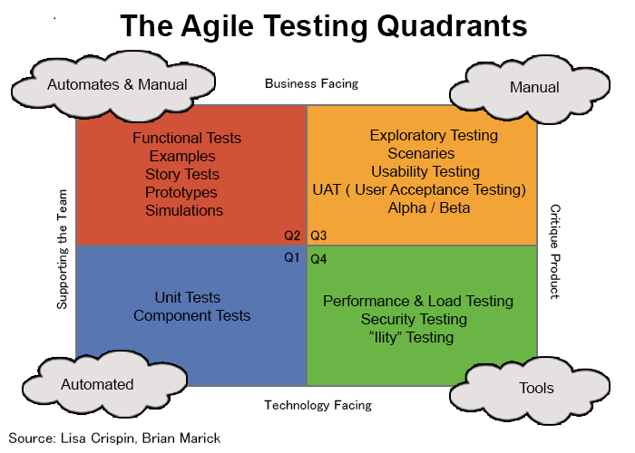
Agile Testing Quadrants
Created by Brian Marick. It divides testing into four categories.

Slide 8
Agile Testing Quadrants
Quadrant 1 (Q1)
Technology Facing
Supports Developers
Purpose
Ensure code works correctly
Examples
Unit Testing
Component Testing
API Testing
Example: If user is able to login
Quadrant 2 (Q2)
Business Facing
Supports Team
Checks whether business requirements are met.
Examples
Acceptance Testing
User Story Testing
Prototype Validation
Example: If user is able to login and transfers money to another user

Slide 9
Agile Testing Quadrants
Quadrant 3 (Q3)
Business Facing
Critiques Product
Human testing
Examples
Exploratory Testing
User Acceptance Testing
Usability Testing
Example:
Software works,
But user experience is poor.
Quadrant 4 (Q4)
Technology Facing
Critiques Product
Checks quality
Examples
Performance Testing
Security Testing
Load Testing
Stress Testing
Example:
Can website handle 10000 users?

Slide 10
Test Driven Development (TDD)
Acceptance Tests
Write the test before writing the code
Acceptance Tests verify: Does the software satisfy customer requirements?
If everything works then the Requirement is accepted.
Benefits of TDD
Better quality
Fewer bugs
Cleaner code
High confidence
Easier maintenance

Slide 11
Refactoring
Automation
Refactoring means: Improving code without changing its functionality
Automate repetitive work
Common Automation Tools
Selenium
Cypress
Playwright
JUnit
NUnit
TestNG
PyTest
Postman (API Testing)
Bad Code
if(a==true)
Better
if(a)
Output remains same.
Code becomes cleaner.

Slide 12
Test Automation Pyramid
The Test Automation Pyramid is a strategy that recommends having many fast Unit Tests at the bottom, fewer Integration Tests in the middle, and a small number of slower UI/End-to-End Tests at the top
The Test Automation Pyramid tells us:
Write lots of small, fast tests and fewer large, slow tests
The bottom is large because we should have many Unit Tests.
The top is small because we should have fewer UI Tests

Slide 13
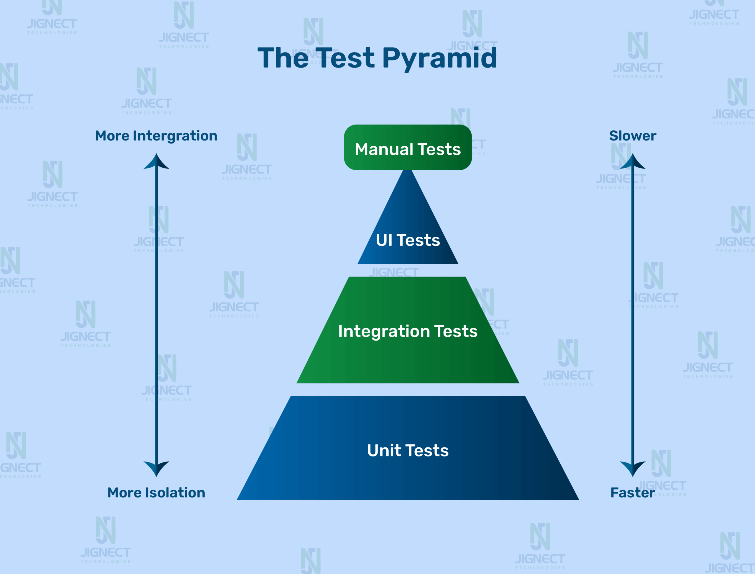

Slide 14
Test Automation Pyramid
Level 1: Unit Tests
Unit testing checks the smallest piece of code, usually a function or method.
Imagine you are developing a food-delivery application.
You have a function:
calculateTotal(price, tax)
You can test:
calculateTotal(100, 10)
Expected = 110
That's a Unit Test.

Slide 15
Test Automation Pyramid
Level 2: Integration Tests
Now we know individual components work. But do they work together?
A user clicks:
"Pay ₹500"
We need to check:
Payment Request
↓
Payment API
↓
Bank
↓
Database
↓
Payment Successful
Everything may work individually, but perhaps the API cannot communicate with the database.
Integration testing catches such problems

Slide 16
Test Automation Pyramid
Open Browser
↓
Open Amazon-like website
↓
Login
↓
Search "Laptop"
↓
Select Laptop
↓
Add to Cart
↓
Checkout
↓
Make Payment
↓
Verify Order
Level 3: UI / End-to-End Tests
This is the top of the pyramid.
Here we test the complete application from the user's point of view.
Imagine an online shopping application.

Slide 17
Example: Pizza Ordering App 🍕
Open App -> Login -> Choose Pizza -> Add to Cart -> Apply Coupon-> Pay- > Order Confirmed
10–20 important UI tests
Order System
Payment System
Database
50 integration tests
calculatePizzaPrice()
calculateGST()
applyCoupon()
calculateDeliveryCharge()
500 unit tests

Slide 18
⭐ Golden Rule
Remember this:
Test as low in the pyramid as possible.
If something can be tested using a Unit Test, don't unnecessarily test it through the UI.
For example:
❌ Don't open a browser just to check whether:
2 + 3 = 5
Use a Unit Test!

Slide 19
Agile Testing Workflow
Requirement
↓
Write Acceptance Criteria
↓
Write Unit Tests (TDD)
↓
Develop Feature
↓
Run Unit Tests
↓
Run Integration Tests
↓
Run UI Tests
↓
Acceptance Testing
↓
Refactor Code
↓
Deploy

